Slide 1

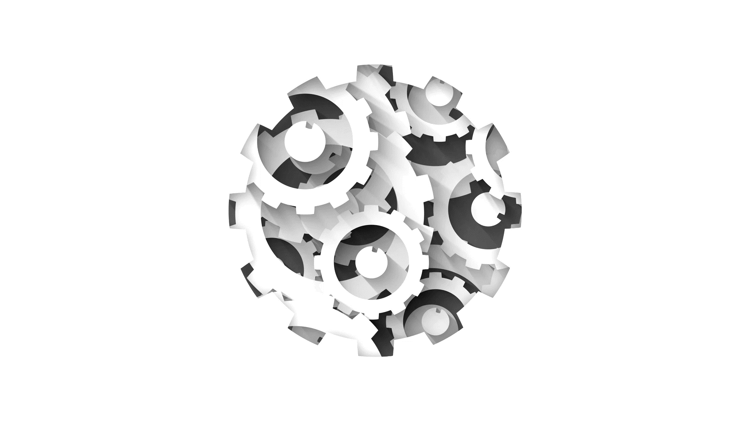


Efficient Machine Learning and Machine Learning for Efficiency in Information Retrieval
Workshop on Reaching Efficiency in Neural Information Retrieval
Bhaskar Mitra
Principal Researcher
Microsoft Research
@UnderdogGeek bmitra@microsoft.com

Slide 2
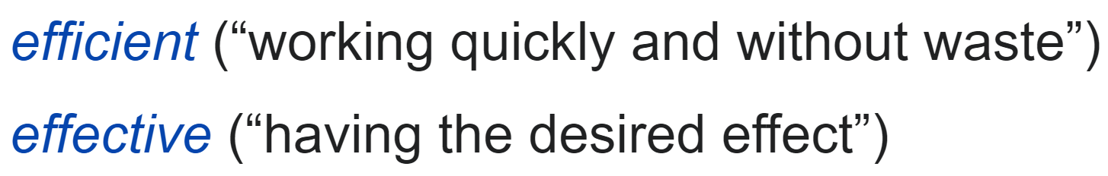
Source: https://en.wiktionary.org/wiki/efficient

Slide 3
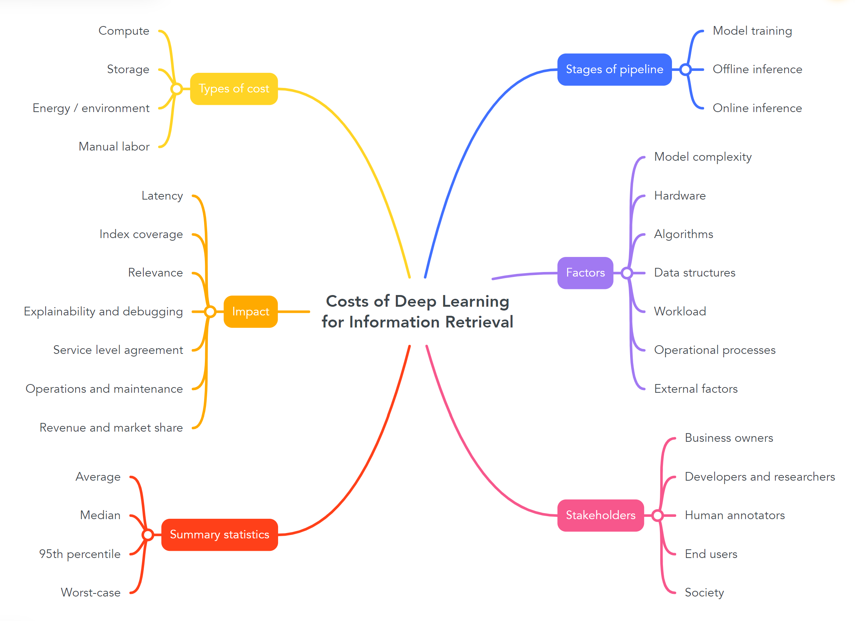

Key points:
Complex trade-offs between different costs makes benchmarking challenging
Typical playbook for efficiency: find cheaper approximation, trade-off other costs, reduce task
Machine learning can be employed to directly improve efficiency of large-scale IR systems

Slide 4

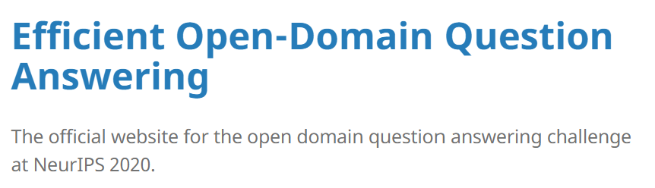

Challenges of benchmarking for efficiency
(Some relevant examples from our NLP peers)
SustaiNLP (2020) Shared Task
Website: https://sites.google.com/view/sustainlp2020/shared-task
Paper: https://aclanthology.org/2020.sustainlp-1.24.pdf
Benchmarks effectiveness and inference-time energy-consumption
What do we measure and what do we control for? How do we capture trade-offs between measures?
What stages of the pipeline can we evaluate?
How do we test the benchmark for construct validity and prevent negative externalities?
NeurIPS 2020 EfficientQA Competition
Website: https://efficientqa.github.io/
Paper: http://proceedings.mlr.press/v133/min21a/min21a.pdf
Benchmarks effectiveness while grouping submitted systems by their inference-time docker image size
ELUE (Efficient Language Understanding Evaluation)
Website: http://eluebenchmark.fastnlp.top/
Paper: https://txsun1997.github.io/papers/elue_paper.pdf
(Benchmarks effectiveness, number of model parameters, and inference-time FLOPs)
What would a TREC Neural Efficiency Track look like?

Slide 5
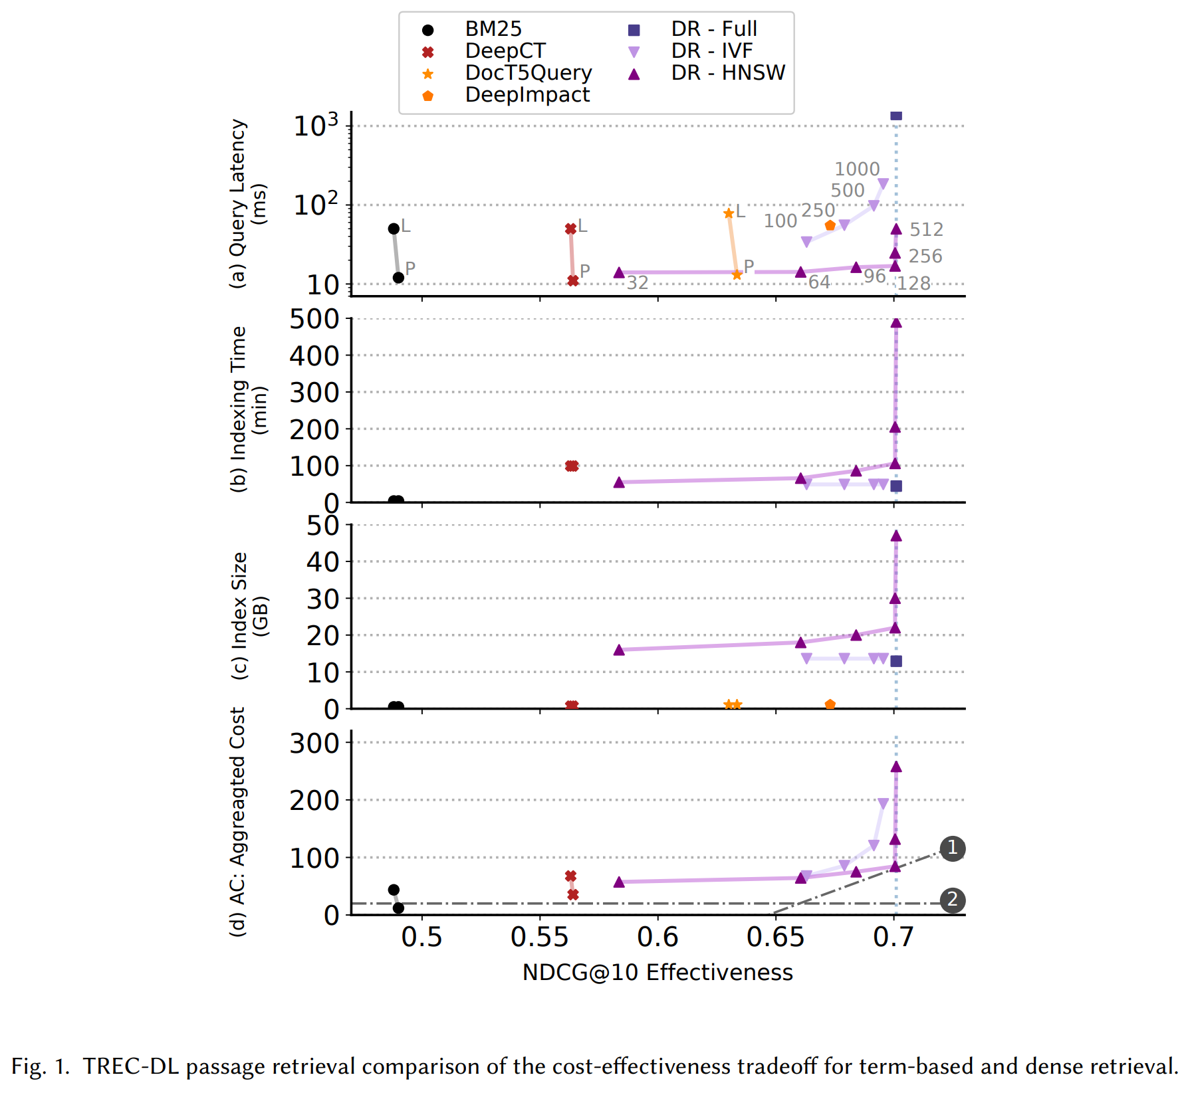
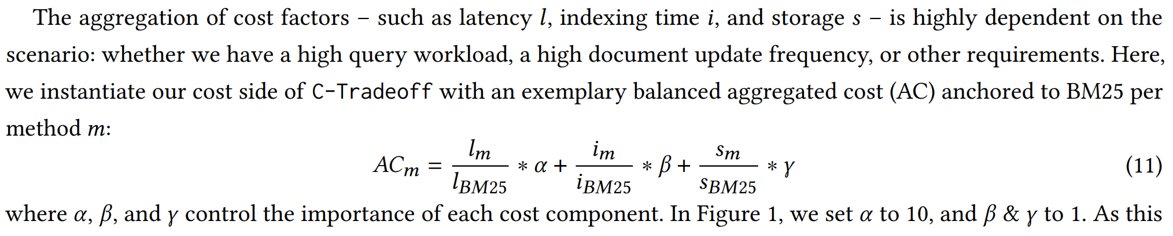
Benchmarking by jointly considering effectiveness, efficiency, and robustness
A preliminary framework:
Identify key measures of effectiveness, efficiency, and robustness
Measures can either be traded-off against each other, or act as guardrails
Apply value-laden and business-informed trade-offs between cost and robustness measures to define aggregate measures, e.g.,
Identify the set of acceptable solutions (again) based on value-laden and business-informed trade-offs decision boundaries
Hofstätter, Craswell, Mitra, Zamani, and Hanbury. Are We There Yet? A Decision Framework for Replacing Term-Based Retrieval with Dense Retrieval Systems. ArXiv preprint. (2022)

Slide 6
Developing more efficient neural IR models
This playbook has been useful in allowing explorations of more ambitious architectures and then reducing their costs / footprints to make them practically deployable in large commercial settings
However, we should ask:
Would we build different models if we are informed by broader system design (data structures and algorithms) and cost considerations from the very start?
Are groups with access to large compute resources adequately incentivized to consider efficiency as early as possible in the development process, especially given that large compute resources can be a competitive advantage?
Are we missing out on use-cases where machine learning is employed specifically to improve efficiency, instead of effectiveness?
Identify key efficiency bottlenecks and costs
Find cheaper approximations, or trade-off with other costs, or reduce the task
Develop more complicated models optimizing only for effectiveness
A typical model development playbook

Slide 7
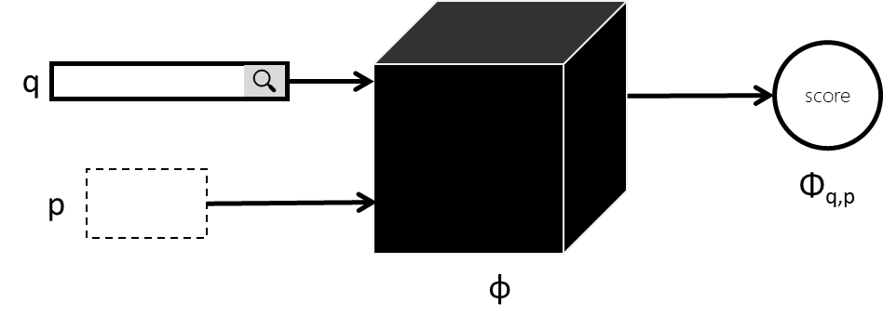

Case studies: Scaling BERT-based relevance models to long documents and full retrieval settings
How do we scale to longer documents?
Bottleneck: Peak GPU memory during training
How do we scale to full retrieval from large collections?
Challenge: Collection size vs. expected online query response time
Nogueira and Cho (2019)
🤔

Slide 8
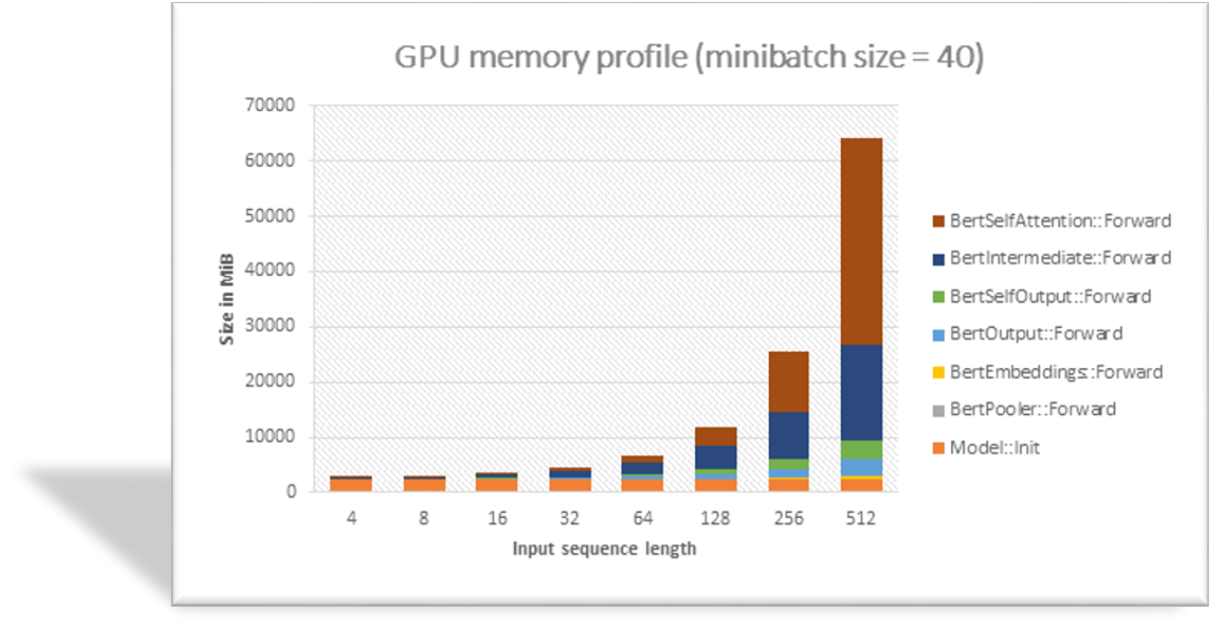
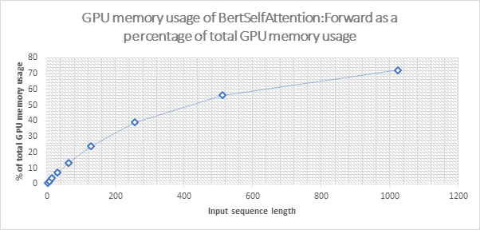
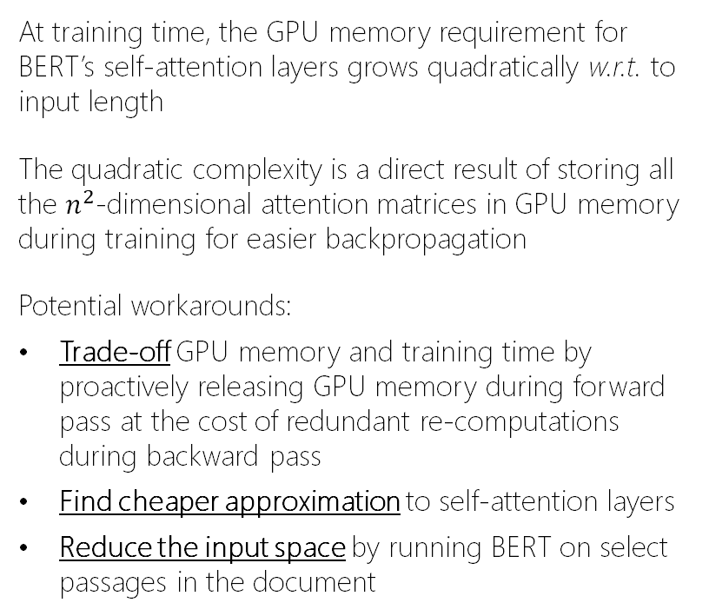
Challenges in scaling BERT to longer inputs
At training time, the GPU memory requirement for BERT’s self-attention layers grows quadratically w.r.t. to input length
The quadratic complexity is a direct result of storing all the $n^{2}$-dimensional attention matrices in GPU memory during training for easier backpropagation
Potential workarounds:
Trade-off GPU memory and training time by proactively releasing GPU memory during forward pass at the cost of redundant re-computations during backward pass
Find cheaper approximation to self-attention layers
Reduce the input space by running BERT on select passages in the document

Slide 9

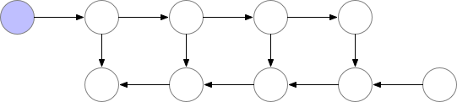
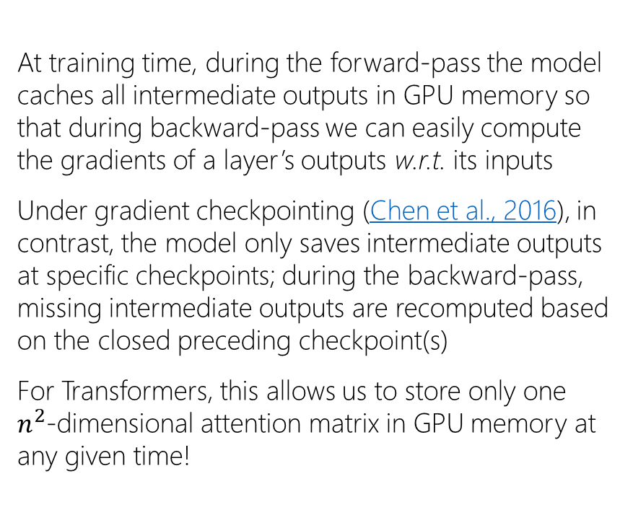
Trade-off GPU memory and training time using gradient checkpointing
At training time, during the forward-pass the model caches all intermediate outputs in GPU memory so that during backward-pass we can easily compute the gradients of a layer’s outputs w.r.t. its inputs
Under gradient checkpointing (Chen et al., 2016), in contrast, the model only saves intermediate outputs at specific checkpoints; during the backward-pass, missing intermediate outputs are recomputed based on the closed preceding checkpoint(s)
For Transformers, this allows us to store only one $n^{2}$-dimensional attention matrix in GPU memory at any given time!
Stored in GPU memory
Without gradient checkpointing:
With gradient checkpointing:
checkpoint
https://medium.com/tensorflow/fitting-larger-networks-into-memory-583e3c758ff9

Slide 10
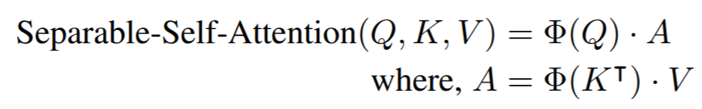
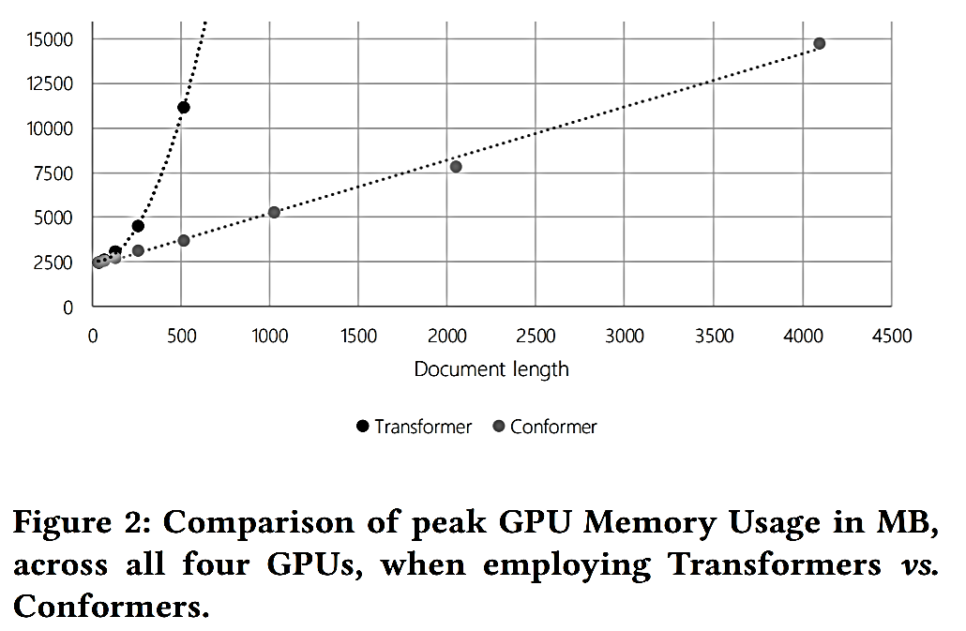
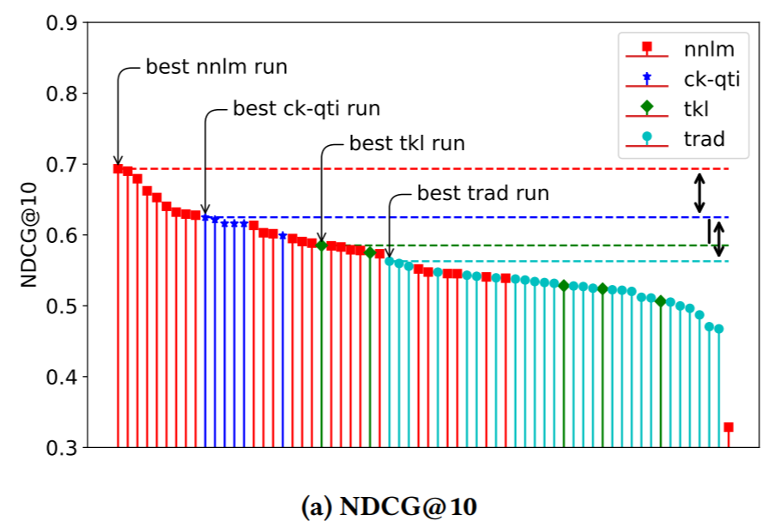
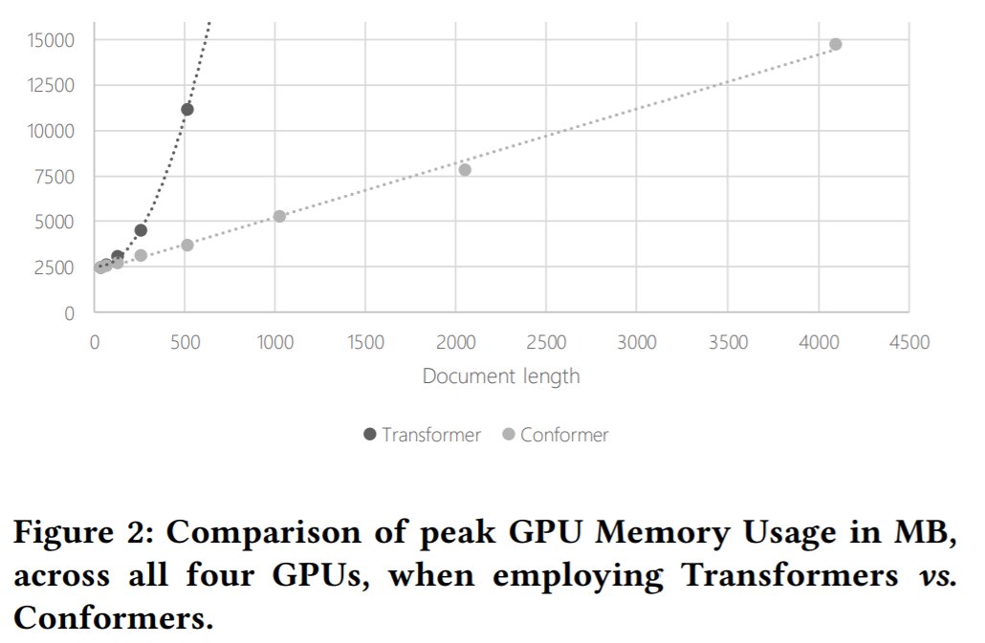
Cheaper approximation: Transformer → Conformer
Conformer is an alternative to Transformer that employs a separable self-attention layer with linear GPU memory complexity (as opposed to Transformer’s quadratic complexity) and is augmented with additional convolutional layers to model short-distance attention
TREC 2020 Deep Learning Track
(Document Ranking Task)
Mitra, Hofstätter, Zamani, and Craswell. Conformer-Kernel with Query Term Independence for Document Retrieval. ArXiv preprint. (2020)
Mitra, Hofstätter, Zamani, and Craswell. Conformer-Kernel with Query Term Independence at TREC 2020 Deep Learning Track. In Proc. TREC. (2020)
Mitra, Hofstätter, Zamani, and Craswell. Improving Transformer-Kernel Ranking Model Using Conformer and Query Term Independence. In Proc. SIGIR. (2021)

Slide 11
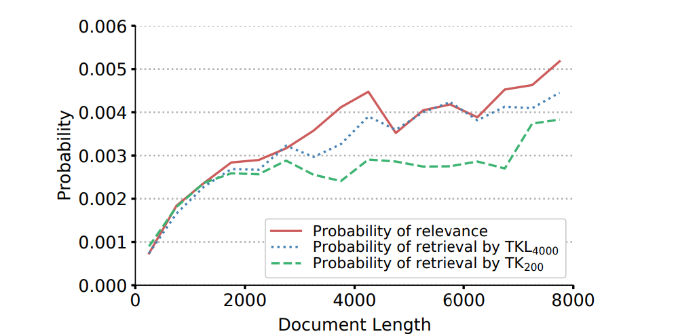
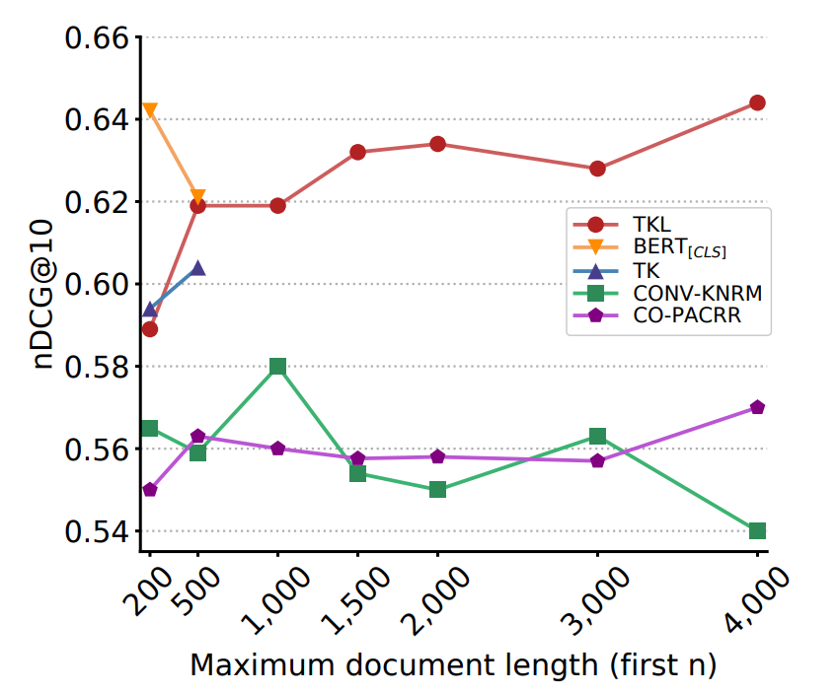
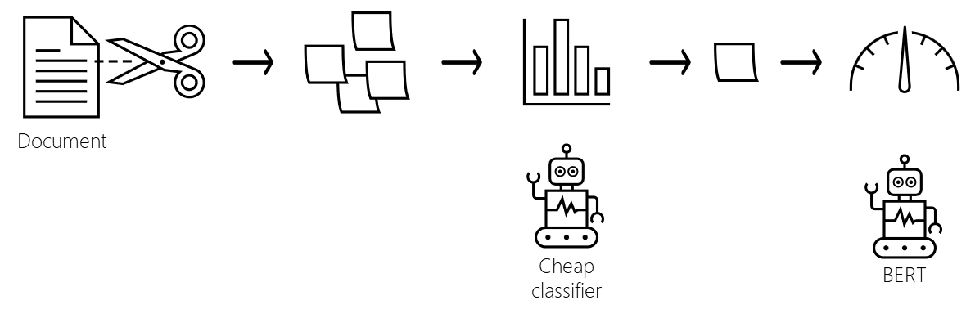
Reduce the task: Passage-based document ranking
Strategy 1: Run BERT on first-k tokens from the document
Considering only the first-k tokens leads to underestimation of relevance and consequently under-retrieval of longer documents (Hofstätter et al., 2020). Recent studies (Kazai et al., 2022) have also analyzed when single snippets are insufficient for both human and machine learning based relevance estimation.
Strategy 2: Run BERT on multiple windows of k-tokens each from the document
This is the approach proposed by Hofstätter et al. (2020). However, the number of windows can be large corresponding to longer documents and running BERT too many times per query-document pair can also be prohibitively costly.
Strategy 3: Run BERT on windows of text pre-selected using cheaper models
This is the approach proposed by Hofstätter et al. (2021). The approach (IDCM) was motivated by cascaded ranking pipelines, but in this case the cascades are employed within-document for passage selection.
Hofstätter, Zamani, Mitra, Craswell, and Hanbury. Local Self-Attention over Long Text for Efficient Document Retrieval. In Proc. SIGIR. (2020)
Hofstätter, Mitra, Zamani, Craswell, and Hanbury. Intra-Document Cascading: Learning to Select Passages for Neural Document Ranking. In Proc. SIGIR. (2021)
Kazai, Mitra, Dong, Zamani, Craswell, and Yang. Less is Less: When Are Snippets Insufficient for Human vs Machine Relevance Estimation? In Proc. ECIR. (2022)

Slide 12
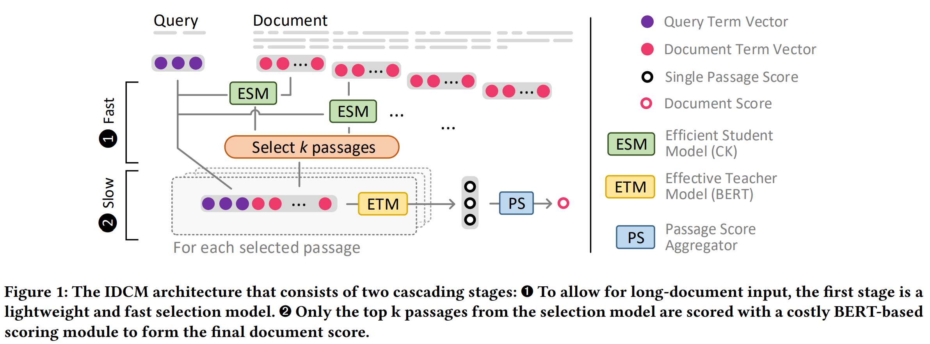
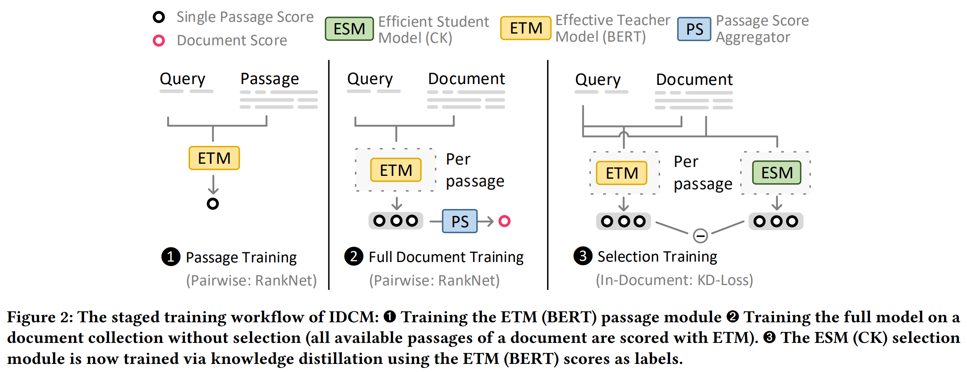
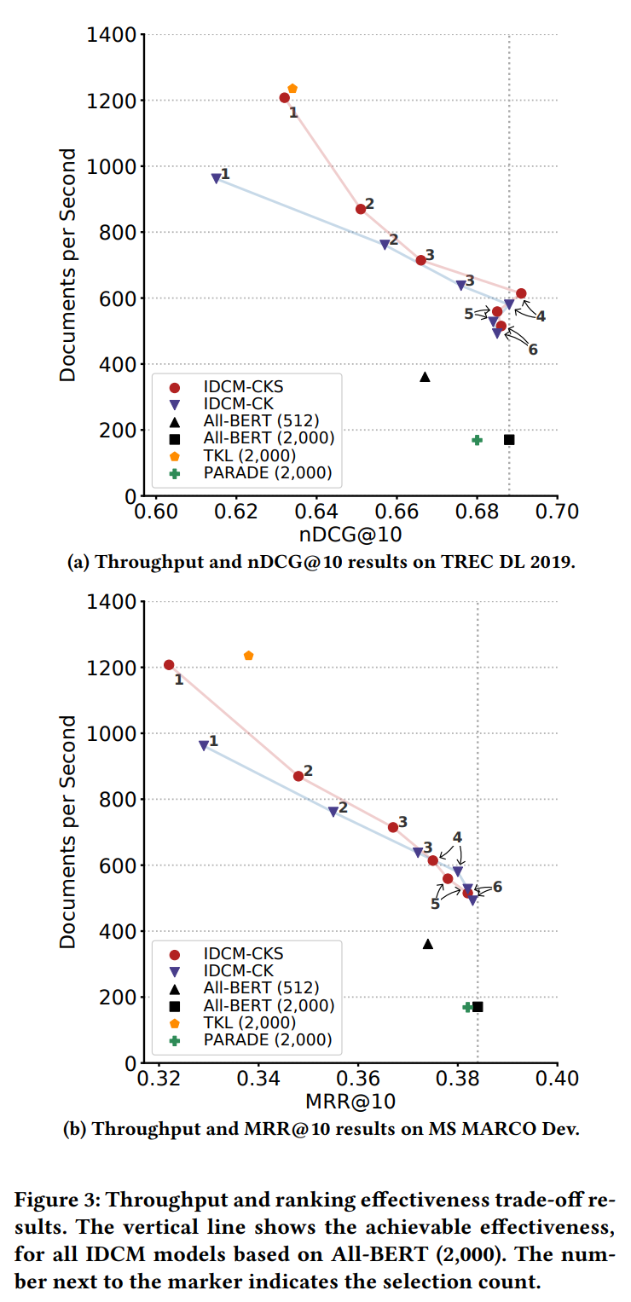
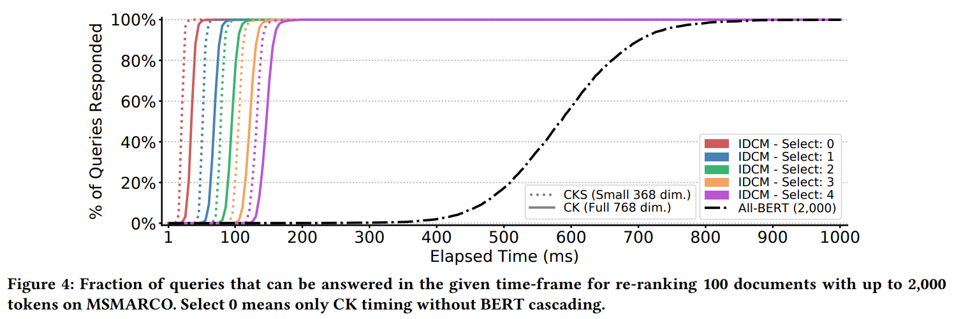
Intra-Document Cascaded Model (IDCM)
We employ a cascaded architecture: a cheaper model ranks-and-prunes candidate passages and costlier BERT model inspects only selected passages from the document
The cheaper model is trained via knowledge distillation from the BERT model
Hofstätter, Mitra, Zamani, Craswell, and Hanbury. Intra-Document Cascading: Learning to Select Passages for Neural Document Ranking. In Proc. SIGIR. (2021)

Slide 13
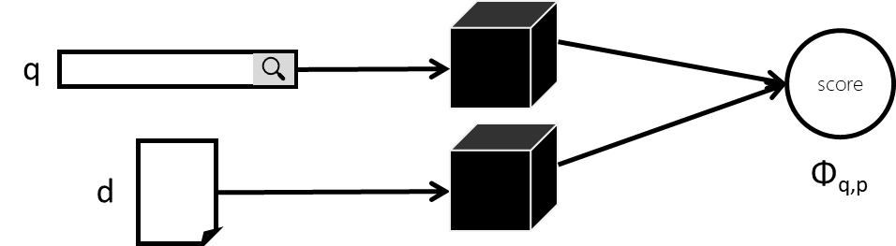
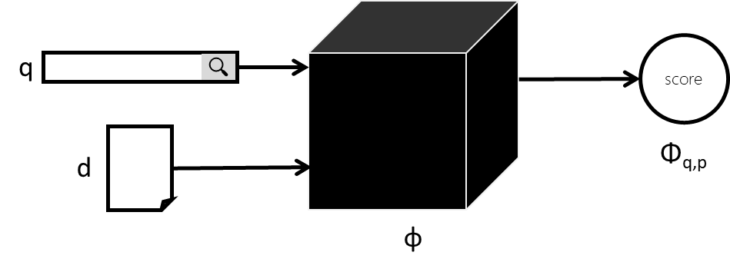
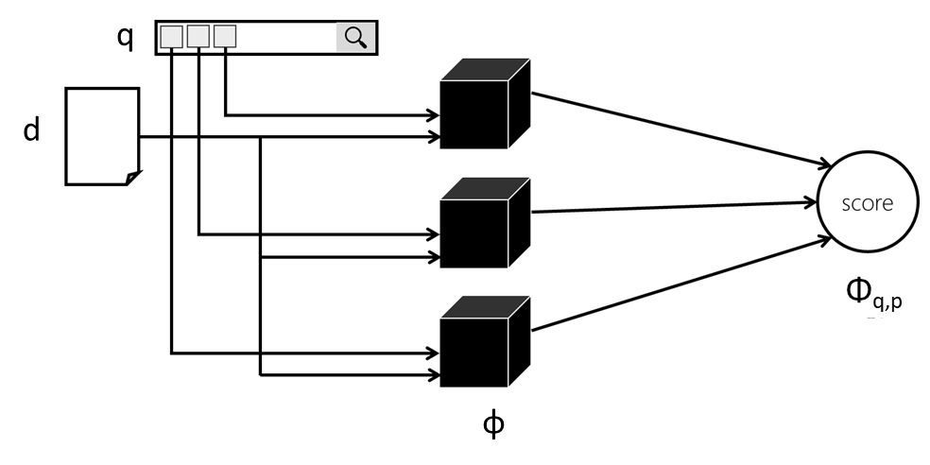
Challenges in scaling BERT to full retrieval
Dense retrieval: Xiong et al. (2021), Qu et al. (2021), Hofstätter et al. (2021), and others
Nogueira and Cho (2019)
Broadly two sets of approaches have emerged: Dense retrieval and Query Term Independent (QTI) models; both precompute document representations at indexing time and require very little computations at query response time
QTI: Mitra et al. (2019), Nogueira et al. (2019), Dai and Callan (2020), and others
Mitra, Rosset, Hawking, Craswell, Diaz, and Yilmaz. Incorporating Query Term Independence Assumption for Efficient Retrieval and Ranking Using Deep Neural Networks. ArXiv preprint. (2019)
Mitra, Hofstätter, Zamani, and Craswell. Conformer-Kernel with Query Term Independence for Document Retrieval. ArXiv preprint. (2020)
Mitra, Hofstätter, Zamani, and Craswell. Conformer-Kernel with Query Term Independence at TREC 2020 Deep Learning Track. In Proc. TREC. (2020)
Mitra, Hofstätter, Zamani, and Craswell. Improving Transformer-Kernel Ranking Model Using Conformer and Query Term Independence. In Proc. SIGIR. (2021)

Slide 14
A note about distillation
A popular recipe involves pretraining/finetuning large models and then knowledge distillation to smaller models that can be deployed in real-world retrieval systems
Pretrained model
e.g., 24-layer BERT
Finetuned model
e.g., 24-layer BERT
Distilled model
e.g., smaller model, or dense retriever, or QTI, or early-stage cascade model

Slide 15
Machine Learning for Retrieval Efficiency
In IR, predictive machine learning has largely been employed for relevance estimation
Kraska et al. (2018) were one of the earliest to propose learned index structures where predictive machine learning is employed to speed up search over classical data structures
Opinion: I believe there’s a significant opportunity to employ deep learning and other machine learning approaches to directly optimize for efficiency in our search and recommendation stacks
Let’s look at an example…

Slide 16
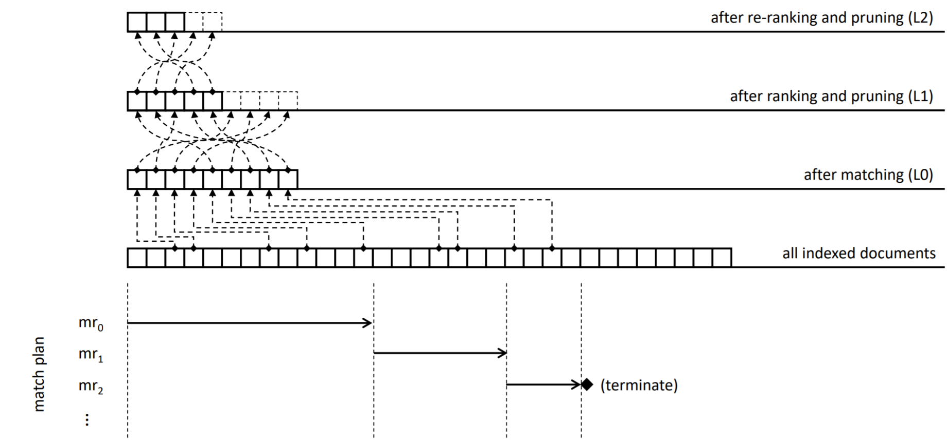
Large scale IR systems trade-off search result quality and query response time
In Bing, we have a candidate generation stage followed by multiple rank and prune stages
Typically, we apply machine learning in the re-ranking stages
In this work, we explore reinforcement learning for effective and efficient candidate generation
Rosset, Jose, Ghosh, Mitra, and Tiwary. Optimizing Query Evaluations Using Reinforcement Learning for Web Search. In Proc. SIGIR. (2018)

Slide 17
In Bing, the index is distributed over multiple machines
For candidate generation, on each machine the documents are linearly scanned using a match plan
Rosset, Jose, Ghosh, Mitra, and Tiwary. Optimizing Query Evaluations Using Reinforcement Learning for Web Search. In Proc. SIGIR. (2018)

Slide 18
When a query comes in, it is automatically categorized, and a pre-defined match plan is selected
A match rule defines the condition that a document should satisfy to be selected as a candidate
A match plan consists of a sequence of match rules, and corresponding stopping criteria
The stopping criteria decides when the index scan using a particular match rule should terminate—and if the matching process should continue with the next match rule, or conclude, or reset to the beginning of the index
Rosset, Jose, Ghosh, Mitra, and Tiwary. Optimizing Query Evaluations Using Reinforcement Learning for Web Search. In Proc. SIGIR. (2018)

Slide 19
Match plans influence the trade-off between effectiveness and efficiency
E.g., long queries with rare intents may require expensive match plans that consider body text and search deeper into the index
In contrast, for popular navigational queries a shallow scan against URL and title metastreams may be sufficient
Rosset, Jose, Ghosh, Mitra, and Tiwary. Optimizing Query Evaluations Using Reinforcement Learning for Web Search. In Proc. SIGIR. (2018)

Slide 20
E.g.,
Query: halloween costumes
Match rule: mr_{A} → (halloween ∈ A|U|B|T ) ∧ (costumes ∈ A|U|B|T )
Query: facebook login
Match rule: mr_{B} → (facebook ∈ U|T )
Rosset, Jose, Ghosh, Mitra, and Tiwary. Optimizing Query Evaluations Using Reinforcement Learning for Web Search. In Proc. SIGIR. (2018)

Slide 21
During execution, two accumulators are tracked
u: the number of blocks accessed from disk
v: the cum. number of term matches in all inspected documents
A stopping criteria sets thresholds for each – when either thresholds are met, the scan using that particular match rule terminates
Matching may then continue with a new match rule, or terminate, or re-start from beginning
Rosset, Jose, Ghosh, Mitra, and Tiwary. Optimizing Query Evaluations Using Reinforcement Learning for Web Search. In Proc. SIGIR. (2018)

Slide 22

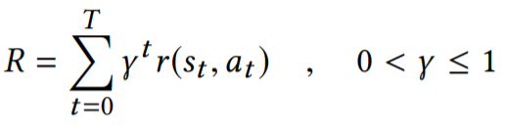





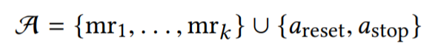
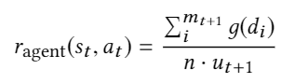

Optimizing query evaluations using reinforcement learning
Learn a policy π_{θ} : S → A which maximizes the cumulative discounted reward R, where γ is the discount rate
We employ table-based Q learning
State space: index blocks accessed (u_{t}) and term matches (v_{t})
Action space:
Reward function:
g(d_{i}) is the relevance of the i^{th} document estimated based on the subsequent L1 ranker score—considering only top n documents
index
accumulators(u, v)
match rule
relevance discounted by index blocks accessed
agent
Rosset, Jose, Ghosh, Mitra, and Tiwary. Optimizing Query Evaluations Using Reinforcement Learning for Web Search. In Proc. SIGIR. (2018)

Slide 23
In summary…
Complex trade-offs between different costs makes benchmarking challenging
Typical playbook for efficiency: find cheaper approximation, trade-off other costs, reduce task
Machine learning can be employed to directly improve efficiency of large-scale IR systems
How can we create a shared task to encourage more efficient deep learning approaches for IR?
What would deep learning models for IR look like if designed with specific retrieval data-structures in mind from the start?
What are the key opportunities to employ predictive machine learning to speed up large-scale retrieval systems?
Questions to the audience…
Thank you!
@UnderdogGeek
bmitra@microsoft.com

